Slide 1
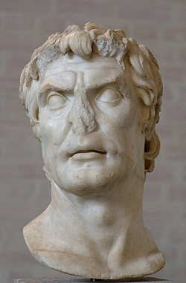
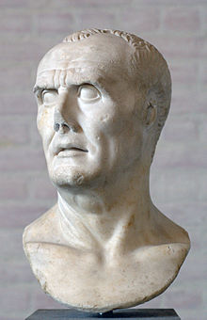
REVISION 1
EST PREPARATION
Week 3, Lesson 4

Slide 2
EST REVISION - Overview
WEEK | Tuesday | Wednesday | Thursday | Friday
3 | X | X | X | Revision 1
4 | Revision 2 | Revision 3 | Revision 4 | Revision 5
5 | EST | Inquiry | Inquiry | Inquiry
6 | Inquiry | Inquiry | Inquiry | Inquiry

Slide 3
Revision Overview
Overview and Questions
Skills and Content
Common Questions
Revision Notes
Content Revision
Gaius Marius and Sulla Revision
Q 1 and 2 – HOW TO
Q 3 and 4 – HOW TO
Q 5 – HOW TO
Question – Worked Example
Marking Key
Sample Answers
Practice Question

Slide 4
Information Sheet
EST skills and content

Slide 5

ACTIVITY - Flashcards
Create a series of flashcards using today’s information
EITHER:
Question Examples
Content

